Slide 1
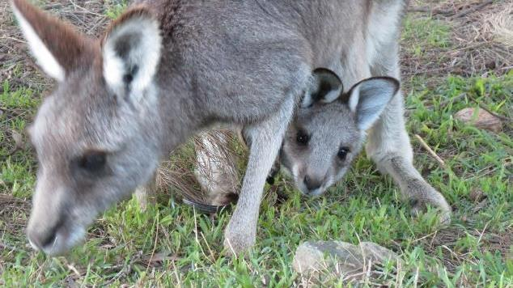
Herpesvirus infection

Slide 2
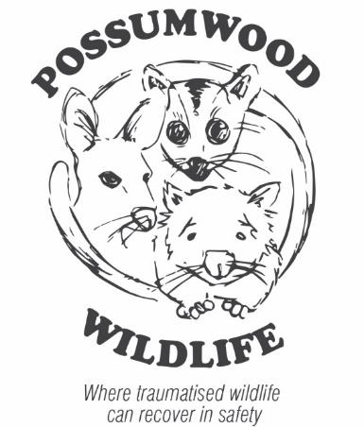
Introduction
Viruses are an important cause of illness & death in all animals including humans and macropods.
Herpesviruses are a large family of DNA viruses.
More than 130 Herpesviruses have been identified in mammals, birds, reptiles, amphibians, fish and molluscs.

Slide 3
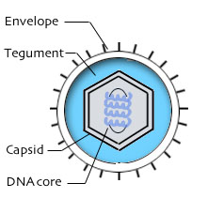
Herpesvirus Structure
Herpesviruses are DNA viruses.
DNA core 100-200 genes.
Encased in protein – Capsid.
Protein layer – Tegument.
Envelope - lipid and glycoprotein.
Virion

Slide 4
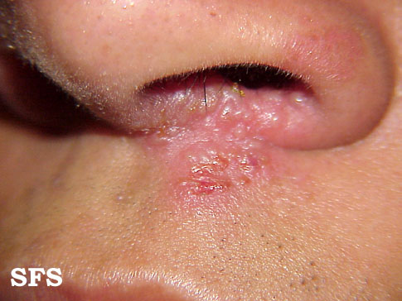

Herpesvirus Classification
Herpesviruses are divided into three sub-families.
  Alpha
  Beta
  Gamma
Common human herpesviruses include:
  Cold sores (HHV-1,alpha);
  Genital Herpes (HHV-2, alpha);
  Chicken pox/ shingles (HHV-3, alpha);
  EBV (Glandular fever, HHV-4, gamma);
  CMV (HHV-5, beta); and
  Kaposi sarcoma herpesvirus (HHV-8, gamma).

Slide 5
Macropod Herpesviruses
MaHV-1, alpha
MaHV-2, alpha
MaHV-4, alpha
MaHV-3, gamma
Novel Gamma Herpesvirus reported in healthy swamp wallabies (Australian Wildlife Health Network, Herpesviruses & Macropods Fact Sheet)

Slide 6
Herpesvirus Lifecycle
Envelope proteins bind to host cell receptors
Virion enters host cell
Viral DNA migrates to host cell nucleus
Viral DNA replicates in the nucleus
Viral genes transcribed
Viral proteins produced
Multiple virions assembled
Host cells mostly lysed as a result of viral infection
In some cells (and thus the host) the virus persists - termed latent
Latent viruses can be reactivated at a later time.

Slide 7
List of Macropods Reported as Hosts for Herpesviruses
Eastern Grey (EG), Western Grey and Red Kangaroos
Black Tree Kangaroo
Black Wallaroo
Swamp, Parma, Tammar and Brush-tailed Rock Wallabies
Quokka
Dusky Pademelon
Brush-tailed and Rufous Bettongs
Long-nosed Potoroo
Source: AWHN, Herpesviruses & Macropods Fact Sheet

Slide 8
Clinical Signs
Discharge from nose and eyes
Sneezing
Fever
Decreased appetite
Conjunctivitis
Keratitis (inflammation of cornea)
Swelling of upper lip and nasal passages
Genital ulcers
Mouth and nasal ulcers
Respiratory signs
Death
Source: Ladds (2009)

Slide 9
Clinical Signs Cont
The American Association of Zoo Veterinarians Infectious Disease Committee Manual 2013 described the alphaherpesviruses as causing fatal systemic infections for which there was no known treatment.
Based on the description in the literature of the clinical signs of both the human and macropod alphaherpesviruses we consider it likely that the virus that has affected the joeys at Possumwood is an alphaherpesvirus.
Source: Ladds (2009)

Slide 10
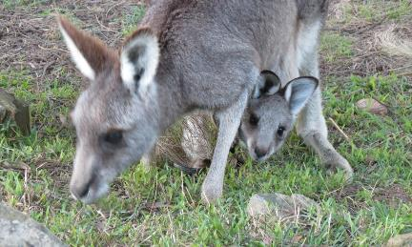
Possumwood Experience: Initial Observation
  First observed 13 years ago
  Toby – 15 kg EG - homesite (soft) release
  Illness signs – sneezing, clear discharge
  from eyes and nostrils, vigorous nose rubbing
  with forepaws
  Other EG Kangaroos released with Toby were observed with the same signs (eg Lizzie)
  Uneventful recovery – no treatment required.

Slide 11
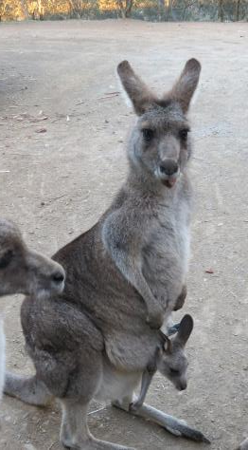
Possumwood: Further Episodes
Episodes of the same symptoms as well as fever
and lethargy were occasionally observed
in EG Kangaroos in enclosures at
Possumwood over the next few years.
All affected EG macropods recovered
uneventfully without treatment
          All affected macropods were > 5kg.
          Several EG females released at
          Possumwood have been observed for 11 years
          and not had a reoccurrence of the illness.
Poppy

Slide 12
Possumwood: Initial Fatal Episode
In 2011 small joeys (<3kg) were exposed to older macropods who had the virus.
These joeys (some raised from 500gm) had no previous exposure to the herpesvirus, had immature immune systems and no protective antibodies from mother’s milk.
        One by one these joeys started to show symptoms of the herpesvirus infection.
        12 of the 15 joeys died despite veterinary involvement, IV antibiotics and fluids, and other supportive care.
        The disease became known locally as kangaroo flu.

Slide 13
Possumwood: Second and Final Fatal Episode
The virus affected another group of small joeys (<3kg). Sophie the first of the group developed signs of the disease and died.
The decision was made to trial a human herpes antiviral called Valaciclovir. This was based on: (1) observations of nasal, cloacal and eye ulcers in EG previously; (2) the correlation with similar signs in human herpesvirus infections.
        As soon as a joey showed signs of the disease, Valaciclovir was commenced. The joeys stopped sneezing in three days and recovered uneventfully and didn’t require other treatment.
        Sophie was the last small joey to die from the herpesvirus at Possumwood.

Slide 14
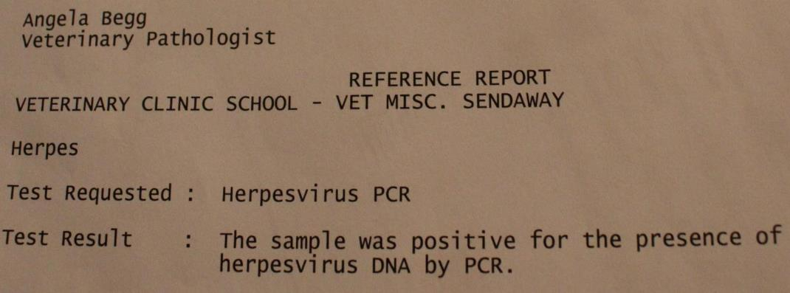
Virus Identification
In 2014 Heidi (2kg EG) was observed sneezing. A viral nasal swab was taken and Valaciclovir was commenced immediately. The disease did not progress and she made a full recovery. The Herpesvirus PCR was positive for the presence of herpesvirus DNA.

Slide 15
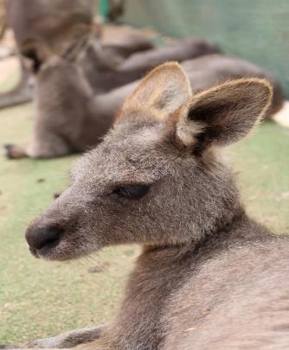
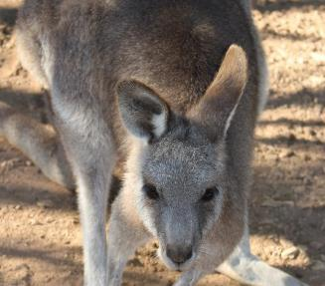
Valaciclovir as Suppressive Treatment
Small joeys being raised with Heidi were given a suppressive dose of Valaciclovir and did not develop signs of the disease.
They appeared to develop immunity to the virus as they did not show signs of the disease when later exposed to the virus.
Subsequently Valaciclovir has been
used successfully by other local carers.
Heidi-12 months after treatment with Valaciclovir and full recovery from the herpesvirus
Spencer received suppressive treatment

Slide 16

Medication
Nucleoside Analogue antivirals
Generic | Brand | Active form in cells
Aciclovir | Zovirax | Aciclovir
Valaciclovir | Valtrex | Aciclovir
Famciclovir | Famvir | Penciclovir
Aciclovir and Penciclovir are phosphorylated in the host cells by a herpesvirus enzyme – thymidine kinase. Hence the specificity for herpesviruses.

Slide 17

Medication Cont
The active triphosphate form of the medication competes with one of the normal bases (the building blocks for DNA) for incorporation into the DNA chain.
The viral DNA polymerase enzyme cannot
continue to elongate the DNA chain and
hence viral replication stops.
        Medication MUST be used early
        at the first sign of a herpesvirus
        infection – less than 48 hours
        after symptoms start.

Slide 18
Why Valaciclovir?
Most common herpes antiviral used in humans
What about Famciclovir? – OTC with pharmacist advice for cold sores.
Cost: Valaciclovir – 42 x500mg tablets for shingles is $25 on private script; Famciclovir – 3x 500mg tablets for cold sores $16.95 OTC.

Slide 19
Medication Dosage
Valaciclovir
  Human dose for shingles is 2x500mg tablets 3xdaily (TDS) for 7 days.
  Joey dose: Crush 1x500mg tablet and suspend in 15ml cooled boiled water. Use 0.5ml/kg of the shaken suspension TDS for 7 days. Keep in fridge for use same day. Apporox 1/ 60th of human dose.
Famciclovir
  Human dose for shingles is 1x250mg tablet TDS for 7 days.
  Joey dose. Crush ¼ x 500mg tablet and prepare and use as described above.
  .

Slide 20
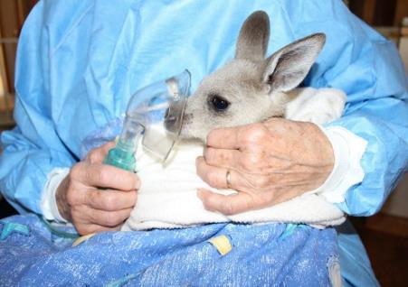

Supportive Care
Joeys who have not been treated with Valaciclovir early in the illness can be treated symptomatically with the following medications – Panadol, Fess nasal saline, Bromhexine, Salbutamol (Ventolin) via nebuliser or inhaler, Amoxycillin and Sucralfate

Slide 21
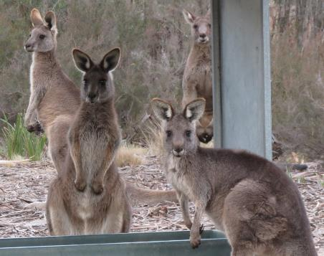
Virus Latency
Latency is the phase in the life cycle of certain viruses in which, after initial infection, proliferation of the virus ceases but the virus is not fully eradicated and remains dormant (latent) within the host cell.
During viral latency there is no active viral shedding and no symptoms of disease. The virus can reactivate in the host cells due to an external activator such as stress to cause an acute infection.
30 rehabilitated EG kangaroos translocated to an enclosure for release site delayed release showed no evidence of herpesvirus reactivation during a 4 month quarantine period.

Slide 22
Summary
A herpesvirus infection has been identified in EG Kangaroos at Possumwood Wildlife Recovery Centre
This herpesvirus infection is often fatal in small EG kangaroos (<5kg) which have an immature immune system.
This disease can be treated with a nucleoside analogue antiviral (Valaciclovir) which is specific for herpesviruses.
        Valaciclovir stops viral replication so it must be used early in the infection to be effective (in first 48 hours).
        As with all antimicrobial medication, Valciclovir should be used judiciously – only in those animals at significant risk of death due to the herpesvirus infection. Healthy older EG Kangaroos do not appear to be at risk of death from this particular herpesvirus.

Slide 23

References
Ladds, P. 2009. Pathology of Australian Native Wildlife, CSIRO Publishing.
Smith, J A, et al. 2008. Identification and isolation of a novel Herpes virus in a captive mob of eastern grey kangaroos (Macropus
Giganteus). Veterinary Microbiology, vol 129, pp. 236-245.
Australian Wildlife Health Network. 2013. Herpesviruses and Macropods Fact Sheet. http://wildlifehealthaustralia.net.au/Portals/0/Documents/FactSheets/Herpesviruses%20(Macropods)%2012%20Feb%202013%20(1.1).pdf Accessed 11/ 7/2016.
American Association of Zoo Veterinarians. 2013. Infectious Disease Committee Manual. http://c.ymcdn.com/sites/www.aazv.org/resource/resmgr/IDM/IDM_Macropod_ Herpesvirus_201.pdf Accessed 11/7/ 2016.
www.possumwood.com.au

Slide 24
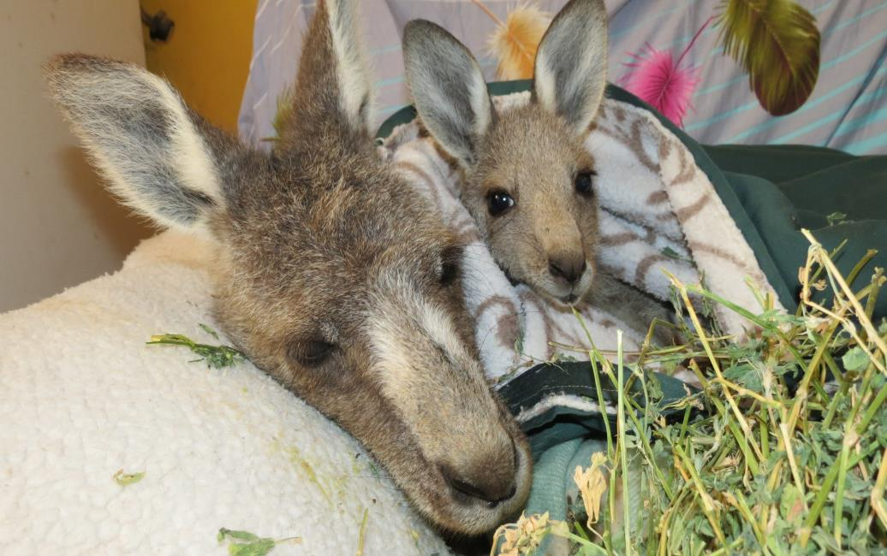
Thank you…

