Slide 1
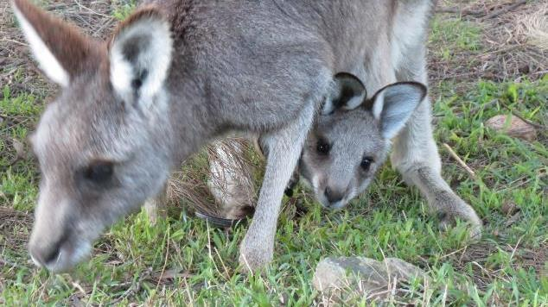
Stress in Macropods

Slide 2
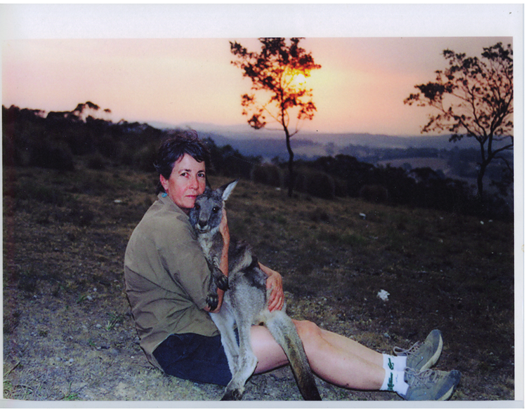
Rosemary & Rudi

Slide 3
Stress in Macropods
Pathophysiology not well understood and a paucity of knowledge in the literature. The term ‘stress myopathy’ is nebulous and inaccurate.
Trigger for a stress syndrome is stress caused by fear or anxiety.
Risk of death is increased by intense physical exertion.
Obvious triggers include macropod caught in a fence or chased by a motor vehicle or dogs, or a joey separated from its mother. Presentation after severe stress varies.
Three stress syndromes will be discussed.
Some triggers are more subtle eg change in carer, relocation to release site or certain noises.
Personality of the animal also plays a role in whether a stress syndrome develops.
Animals with anxiety traits are more likely to develop a stress syndrome.

Slide 4

Important concepts
There are a number of concepts which are important in understanding the development and treatment of stress syndromes.
Sympathetic nervous system & the hormones adrenalin and cortisol
Aerobic & anaerobic metabolism & metabolic acidosis.
Exertional rhabdomyolysis
Polyvagal theory

Slide 5
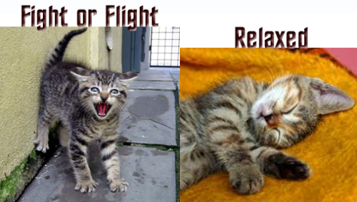
Fear factor
Overwhelming fear & anxiety trigger the sympathetic nervous system & synthesis & release of hormones such as adrenalin and cortisol
Sympathetic - fight or flight
Parasympathetic ventral vagal – rest and digest

Slide 6
Fight or Flight Response
Central Nervous System
CRF
Sympathetic nervous system
Pituitary Gland
ACTH
Adrenal medulla
Adrenal cortex
Adrenalin
Cortisol
Bloodstream
Neural activity combines with hormones in the blood to constitute the fight or flight response

Slide 7
Sympathetic nervous system: Effects
Stimulates release of adrenalin
Stimulates glucose release from liver
Diverts blood away from GIT, kidneys and skin
Enhances blood flow to skeletal muscles (1200%) & lungs
Dilates bronchioles (airways) of lungs allowing better oxygen exchange
Increases heart rate and contractility of heart cells
Dilates cardiac blood vessels
Dilates pupils
Posturing in macropods

Slide 8
The Adrenalin Rush
Adrenalin contributes to the fight or flight response by:
increasing blood flow to the muscles
increasing output of the heart
pupil dilation
increasing blood glucose

Slide 9
Cortisol Contribution
Increasing blood pressure
Increasing blood glucose
Heightened attention
Decreasing sensitivity to pain
As an analogy with respect to the fight or flight response, adrenalin puts the foot on the accelerator. As the initial adrenalin surge subsides, cortisol keeps the accelerator on. When the threat passes, the parasympathetic nervous system ventral vagal branch acts like a brake and dampens the stress response.

Slide 10
Cortisol Results
Normal = <50nmol/L
Name | History | Cortisol initial (nmol/ L) | Cortisol follow up
Swallow | Dog attack, severe injuries | 531 | 56 (after 3 weeks)
Cherry | spinal injury, fox attack, joey taken & pouch torn | 522 | 62 (after 4 weeks)
Big Al | Attacked by 3 dogs | 431
Carrie | Fence hanger, dog attack | 525
Arrow | 70kg male with arrow penetrating eyelid | 24
Lily | Normal | 31
Ginni | Fence hanger, ischemic toe, dislocated hip. | 588
Shannon | Fire victim, alone in a burnt area. Burnt hind feet, unable to hop | 362 | 33 (after 6 weeks)
Cherry Blossom | Attacked by 2 large dogs | 242 | 59 (after 17 days)

Slide 11
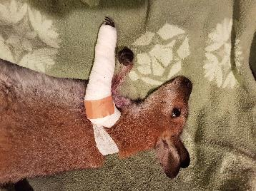
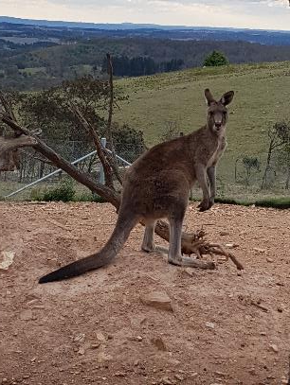
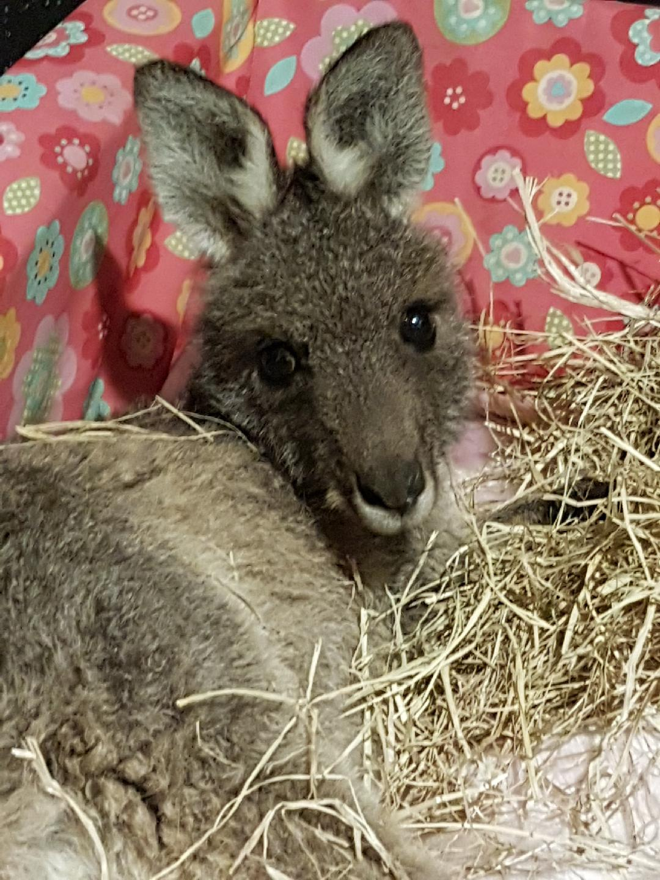
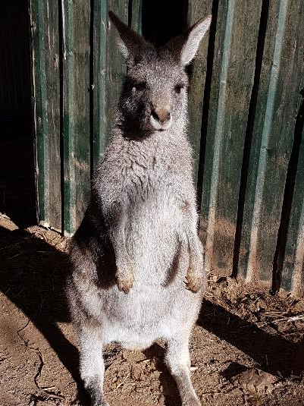
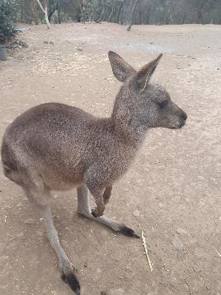
Cortisol case studies
Swallow
Big Al
Lily
Carrie
Cherry Blossom

Slide 12
Aerobic metabolism
Glucose
Glycolysis – in cell cytoplasm
ATP (energy source) + Pyruvate + H⁺ (acid)
O₂
Krebs cycle
Electron transport chain –in cell mitochondria
CO₂ (exhaled during respiration) + H₂O + ATP (energy source)
Produces a total of 34 molecules of ATP, the body’s energy source

Slide 13
Anaerobic metabolism
Glucose
Glycolysis – in cell cytoplasm
ATP (energy source) + Pyruvate + H⁺ (acid)
Lactate
OR
Creatine kinase (CK)
Creatine phosphate
Creatine + energy – in muscle cells
Phosphate + ADP
ATP (energy source)
Useful reference: http://www.teachpe.com/physiology/energy_systems.php

Slide 14
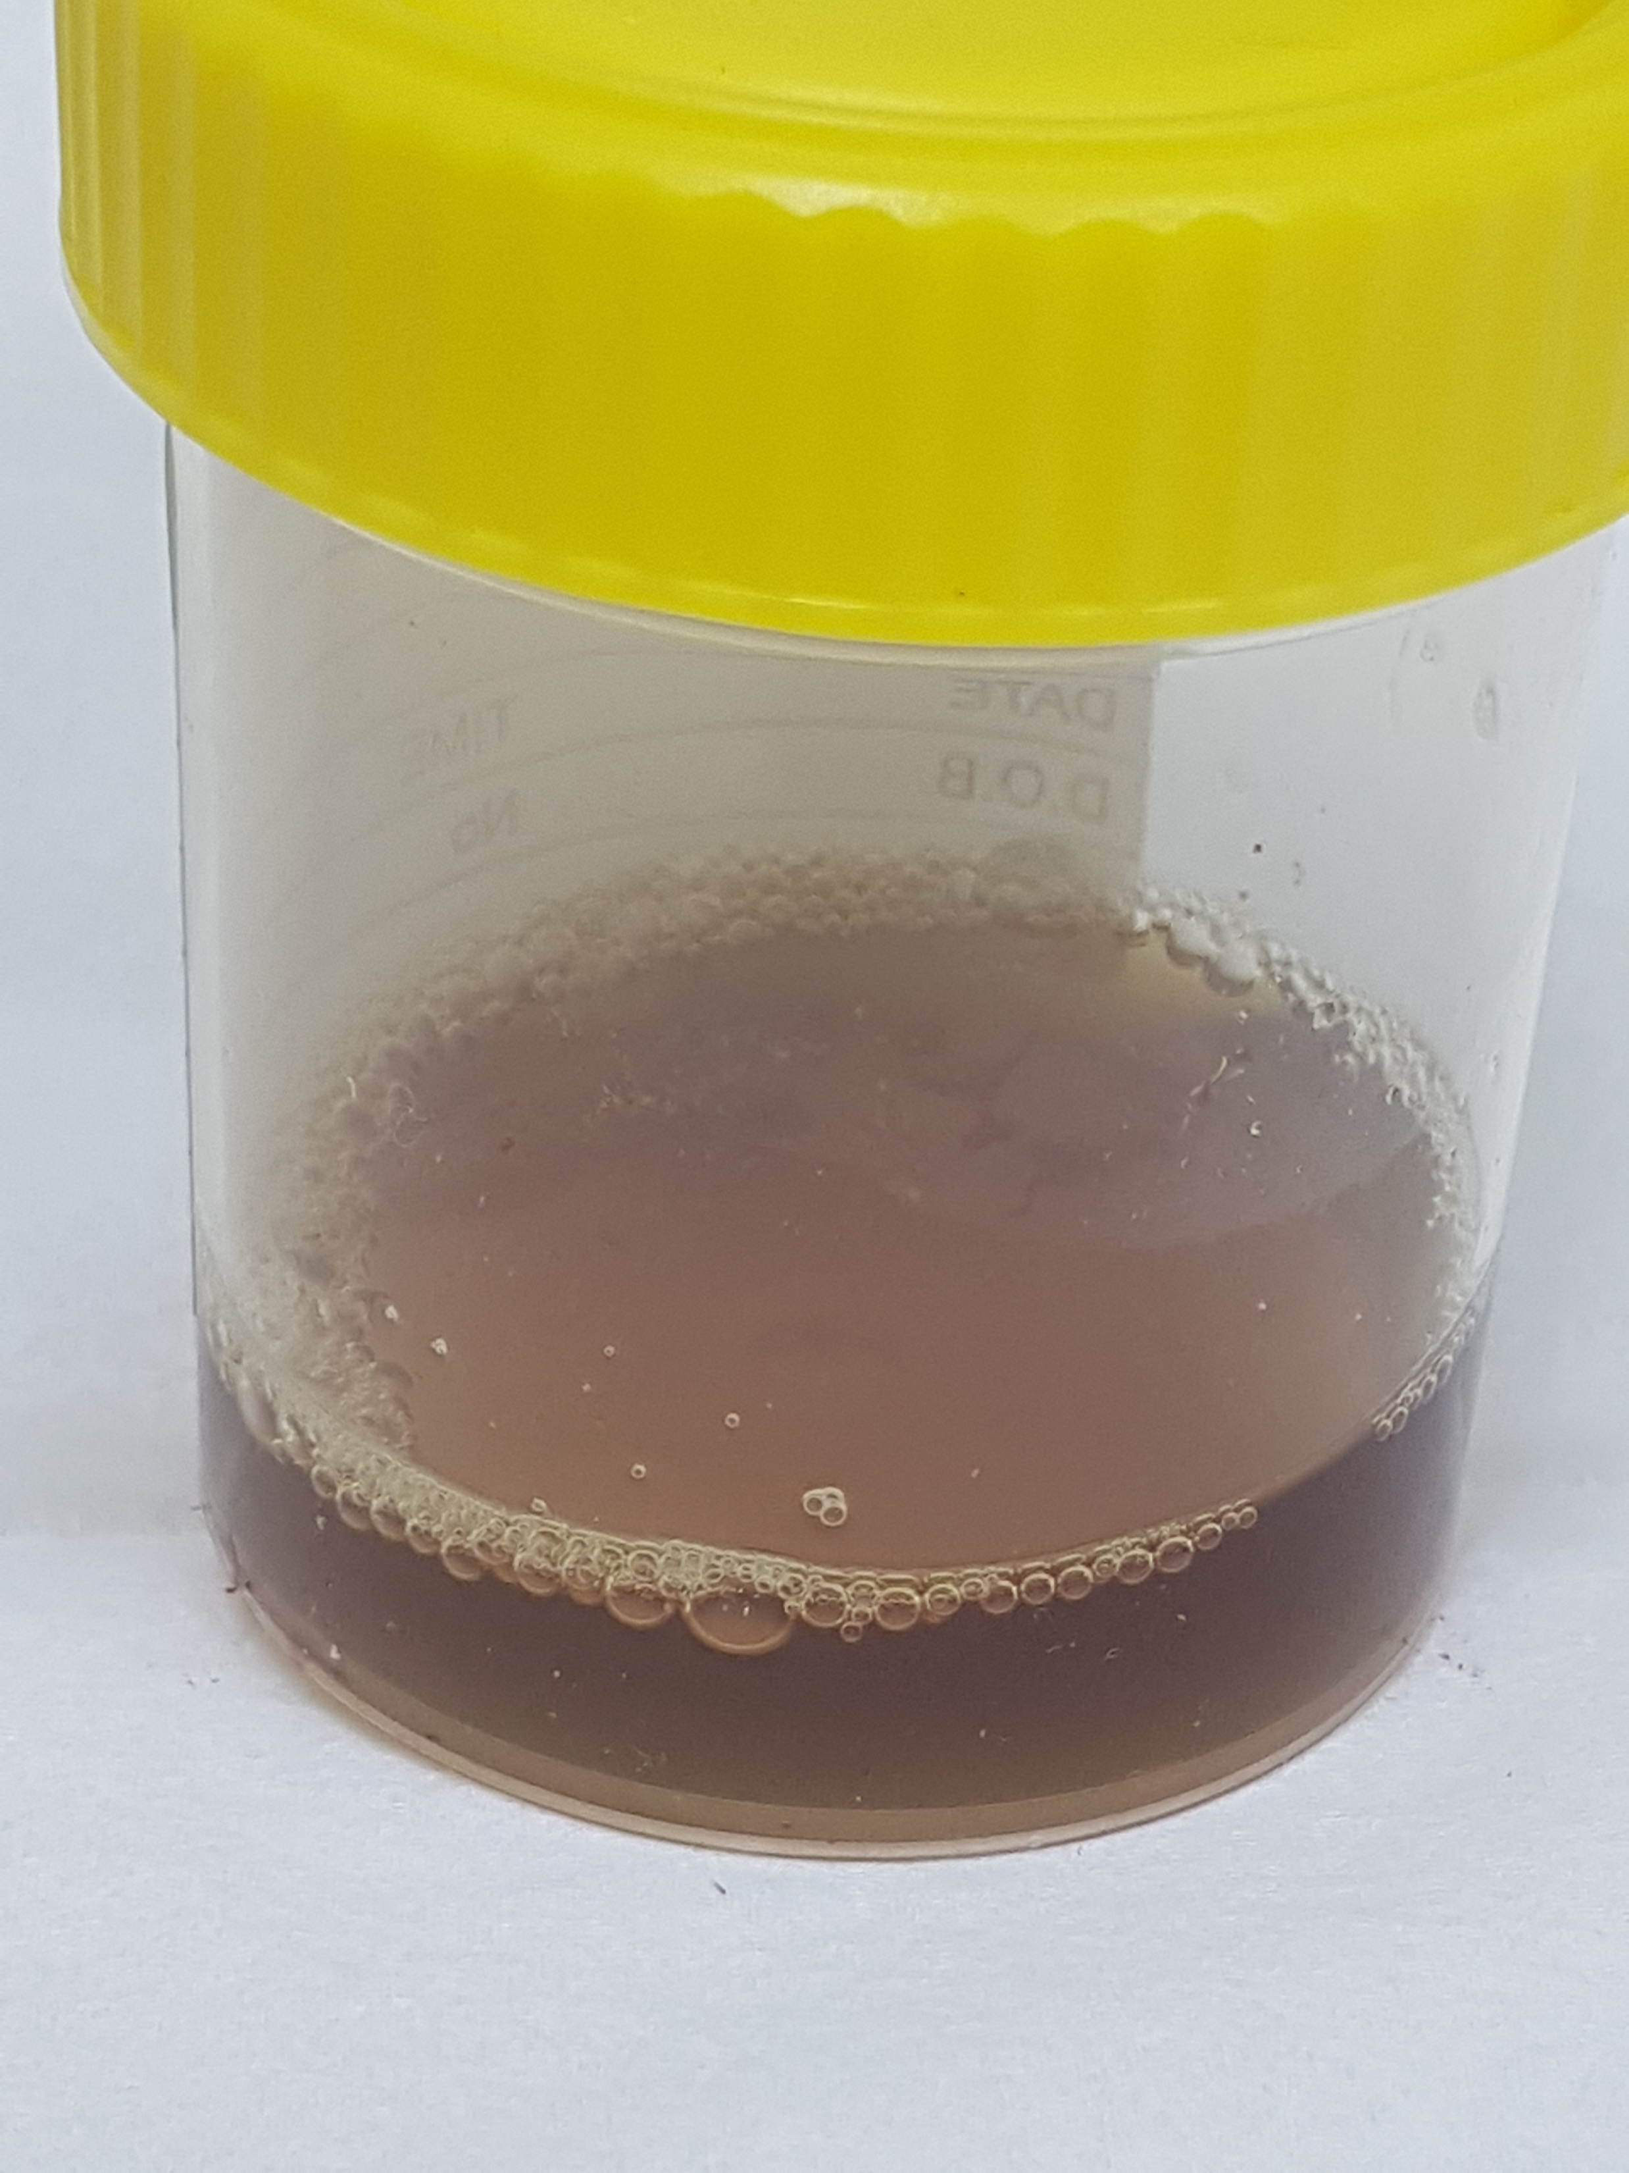
Exertional rhabdomyolysis
Prolonged, strenuous muscle activity in hot conditions can cause exertional rhabdomyolysis especially if associated with dehydration.
The breakdown of the muscle tissue releases the muscle protein myoglobin, enzymes: creatine kinase (CK, AST/ALT and potassium into the blood.
The myoglobin results in dark brown or what is known as ‘Coca Cola’ urine and can result in kidney damage and
consequent renal failure

Slide 15

Stress Syndrome 1
Severity and outcomes variable
Fear or anxiety plus prolonged strenuous muscle activity cause sympathetic stimulation + Adrenalin + Anaerobic metabolism which have the following consequences:
Tissue ischemia due to reduced tissue perfusion
Lactic acidosis
Muscular ATP (energy source) depletion
Muscle cell damage & consequent release of myoglobin & potassium
Compartment syndrome due to muscle swelling
Acid stimulation of nerve endings in muscles causing muscle pain
Rapid respiratory rate due to metabolic acidosis
Cardiac rhythm disturbance due to hyperkalemia (high potassium)
Hyperthermia (temp > 37 deg C)
Kidney damage caused by myoglobin
Acute renal failure if severely dehydrated
Pulmonary oedema

Slide 16
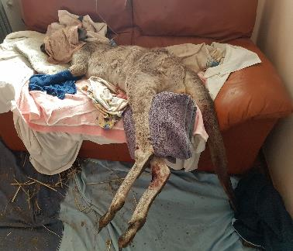
Stress Syndrome 1 - Weroona
  Weroona was hanging by one leg in a fence on a warm day in the sun. On arrival at Possumwood she was severely dehydrated, hyperthermic (39.5c), tachycardic, tachypnoeic.
  She was cooled with wet towels and a fan and IV fluid (NS) were given. She was also given IV sodium bicarbonate to treat lactic acidosis.
  H⁺ + HCO₃⁻ CO₂ + H₂O
  She died within six hours of coming into care.

Slide 17

Test | 21/ 03/ 2019 | 16/ 04/ 2019
Cortisol (nmol/ L) | 531 | 56
Potassium (mmol/ L) | 5.7 | 4.6
Urea (mmol/ L) | 18.8 | 6.9
Creatinine (umol/ L) | 120 | 55
AST (U/ L) | 3343 | 96
Creatine Kinase (U/ L) * Vetnostics data. **Possumwood research. | 82900 | 1829
Normals*
<50**
2.2 – 8.2
4.3 – 17.1
44 – 168
30 – 281
203 – 6868
Swallow
Female Red Neck wallaby attacked by two dogs. Arm severe lacerations and fractures, bites to legs and neck. Small pinkie in pouch died.

Slide 18
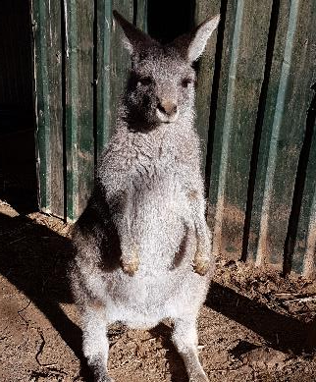
Test** |  | Normals*
Cortisol (nmol/ L) | 525 | <50**
Potassium (mmol/ L) | 6.5 | <6.6
Urea (mmol/ L) | 13.1 | 3.9 – 16.4
Creatinine (umol/ L) | 120 | 88 - 256
AST (U/ L) | 5121 | 8 - 325
Creatine Kinase (U/ L) * Vetnostics data. ** Possumwood research. | 356540 | 172 - 6020
Carrie
Fence hanger & attacked by dog while caught. Deep puncture wound to neck. Mother close by & probably saved her from the dog attack.

Slide 19
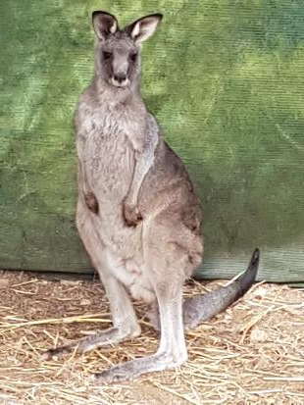
Test |  | Normals*
Cortisol (nmol/ L) | 170 | <50**
Potassium (mmol/ L) | 12.3* | < 6.6
Urea (mmol/ L) | 8.2 | 3.9 – 16.4
Creatinine (umol/ L) | 115 | 82 - 256
AST (U/ L) | 3650 | 8 - 325
Creatine Kinase (U/ L) | 216230 | 172 - 6020
Rovere
Found collapsed in a garden. Hypothermic, likely chased by dogs.
* Vetnostics data. ** Possumwood research.

Slide 20
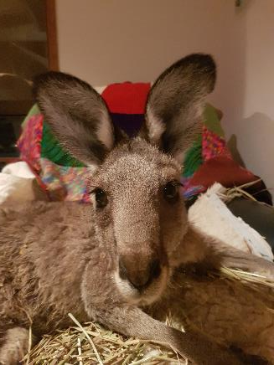
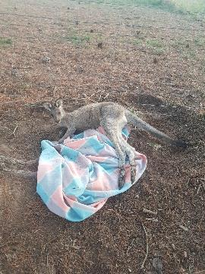
Stress Syndrome 1- Majura
Majura recovered well with treatment and has been released
Test |  | Normals*
Cortisol (nmol/ L) | - | <50**
Potassium (mmol/ L) | 5.2 | < 6.6
Urea (mmol/ L) | 13.3 | 3.9 – 16.4
Creatinine (umol/ L | 110 | 82 - 256
AST (U/ L) | 2625 | 8 - 325
Creatine Kinase (U/ L) * Vetnostics data. ** Possumwood research. | 137870 | 172 - 6020

Slide 21
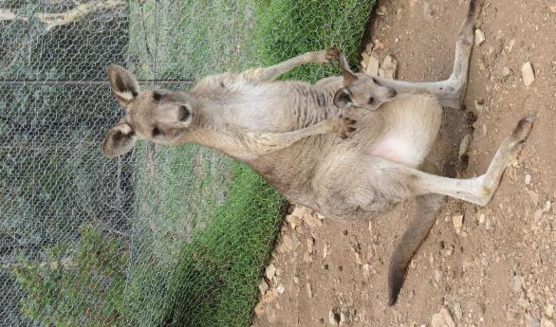

Treatment of stress syndrome 1
Diazepam (0.25 – 0.5mg/ kg SC or IM) – anxiolytic & muscle relaxant
Check temperature (tympanic thermometer - ear)
If hyperthermia (> 37) - cool animal (eg wet towels &
fan). Cool IV fluids most effective but not normally
necessary
If hypothermia (< 35) – warm animal (eg electric throw
rug) around trunk
It is very important to provide fluid therapy ASAP after
rescue. Initially 3% by weight SC NS. Fluids can be given IV
if necessary. Offer water or 1% glucose orally.
Fluid therapy is important to treat dehydration
and prevent acute kidney failure and prevent
kidney damage caused by myoglobin and
consequent chronic renal failure.
Emu – fence hanger survivor

Slide 22
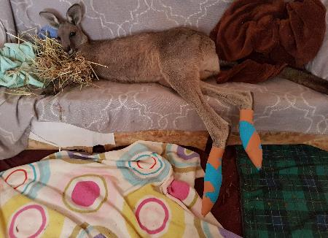
Treatment of stress syndrome 1 (Cont)
If still tachypnoeic after Diazepam & cooling give
sodium bicarbonate intravenous infusion 8.4% – 1ml/kg SC, dose will likely need to be repeated
Analgesia – Tramadol 1mg/kg IM twice daily or Panadol 10mg/ kg twice daily
Vitamin E/Selenium – 1mg/ ml selenium & 50mg/ ml Vit E (0.05ml/ kg IM) once daily for 3 days
Optional – Haloperidol decanoate 50mg/ml IM – maximum 5 mg/ kg. Haloperidol is an anxiolytic and according to human patients has
less side effects than Diazepam. Helps to switch
animals from the sympathetic ‘fight or flight’ state to
the ventral vagal ‘rest and digest’ state.
Macca, fence hanger

Slide 23
Stress Syndrome 2 - Iggy
  Less common
  Previous stress syndrome1
  Ongoing fight or flight state (PTSD)
  Rapid progression to death after a subsequent stress
  trigger (even if mild).
  Iggy. Mother euthanased, alone for three days, harassed by dogs and then darted and brought into care at 3.5kg. Always hypervigilant, thought to have PTSD. After a minor stressor, Iggy went into a trance-like state – recumbent, muscle fasciculation, respiratory arrest and death within one hour.? The shutdown state of the polyvagal theory.

Slide 24
Stress Syndrome 3
We have observed that some macropods at rescue are already in what could be in a ‘shut down’ dorsal vagal state. These animals are under- responsive, are or are becoming hypothermic, bradycardic and bradypnoeic. They progress to respiratory arrest and death. We are questioning whether a medication like adrenalin could switch them from the parasympathetic ‘shut down’ to the sympathetic ‘fight or flight’ state and then to the ‘rest and digest’ state.
Name | CK | Cort | Temp | HR | RR | BP
Toto (10kg) | 13009 | 257 | 32.4 | 60 | 14 | 102/42

Slide 25
State switching
Fight or Flight state
Rest & Digest state
Shut Down state

