Slide 1
Renal Failure in Macropods

Slide 2
Definition
Renal failure - when the kidneys cannot perform their normal functions, viz: excreting waste (eg urea and creatinine), balancing electrolyte levels (eg sodium and potassium), controlling body fluid, blood pressure, acid balance, red blood cell and vitamin D production
Renal failure can be acute (often reversible) or chronic.

Slide 3
Causes of acute renal failure
Can include:
Dehydration eg. Prolonged strenuous exertion on a hot day
Hypovolemia eg. haemorrhage
Rhabdomyolysis eg. exertional
Medication eg. NSAIDS
Crystalluria blocks urine output

Slide 4
Chronic renal failure
Cause often not obvious
Usually irreversible
May result from: Rhabdomyolysis, Crystal nephropathy, Babesia.

Slide 5
Symptoms
Acute renal failure – macropod passes little (highly concentrated) or no urine
Chronic renal failure – poor weight gain, lethargy, polydipsia, polyuria (often wet bags).

Slide 6
Consequences
Level of waste products increase in blood (urea, creatinine)
Anorexia
Lethargy
Hyperkalemia
Metabolic acidosis
Death

Slide 7
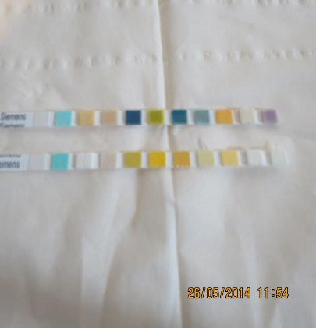
Diagnosis
Urine analysis
Low specific gravity (dilute urine) combined with high urea on blood test
Presence of protein and red blood cells in urine. Kidneys start to leak protein
Confirm with blood test for
urea, creatinine.

Slide 8
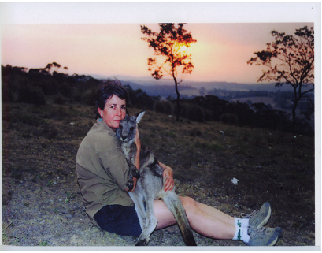
Rudi
Chased by dogs on hot day
Not given intensive fluid therapy for exertional rhabdomyolysis and to treat dehydration and prevent chronic renal failure caused by myoglobin
Very unwell for a number of weeks after incident. Appeared depressed, lethargic with poor appetite and weight loss ? Renal failure? Dorsal Vagal ‘shutdown’.

Slide 9
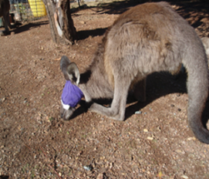
India
Parameter | Result | Std value*
Urea Creatinine Potassium | 164 1425 7.3 | 8.6 mmol/L 133 umol/L 4.2 mmol/L
Sustained an eye injury in release enclosure during a severe storm which brought down a pine tree.
Treated with gentamicin for eye injury but not given fluids to treat the exertional rhabdomyolysis
Developed renal failure. Note elevated urea, creatinine and potassium
.

Slide 10
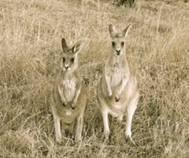
Pino
Came from another carer
Found after release unwell with fox attack injuries to the head. No intensive fluid treatment was given for exertional rhabdomyolysis
Consecutive blood test results indicated progression in her renal failure.
Parameter | Result 10/ 08/ 09 | Result 05/ 09/ 09 | Std Value*
Urea Creatinine Potassium Hb | 38 330 5.8 99 | 56 520 4.9 79 | 8.6 mmol/L 133 umol/L 4.2 mmol/L

Slide 11
Ned, Bob, Lenny, Tulley, Flynn
About 18 years ago four released kangaroos died from what appeared to be renal failure
Ned was unwell for a long period. He lost weight, fur was unkempt and became very dark. He was euthanased
Bob had similar symptoms and had a cardiac arrest in the veterinary surgery
Lenny showed lethargy, weight loss, ‘aeroplane’ ears. Blood tests showed renal failure.

Slide 12
Ned, Bob, Lenny, Tulley, Flynn (Cont)
Tulley - weight loss, lethargy. Euthanased after having a seizure. Post-mortem histopathology indicated chronic kidney disease
Flynn – weight loss, lethargy. Treated with Imidocarb (recommended treatment for Babesia). Flynn made a full recovery.

Slide 13
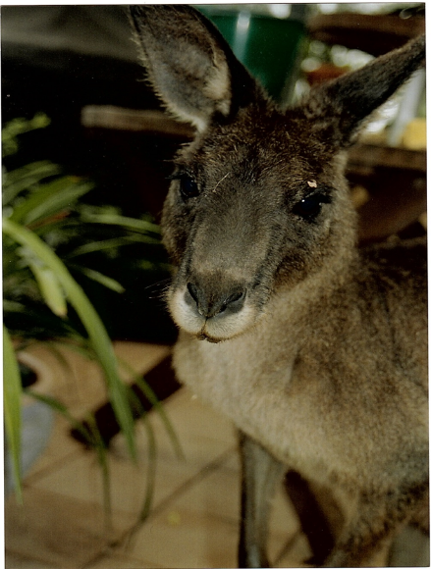
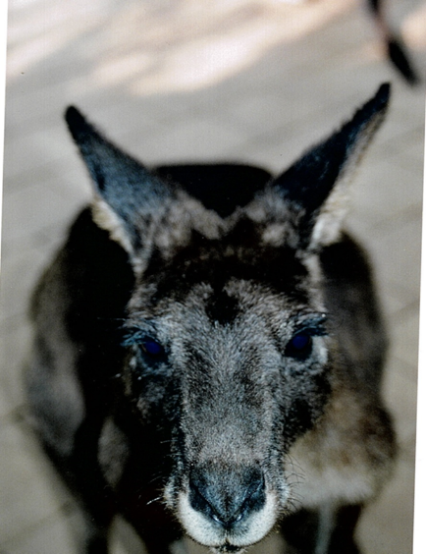
Ned

Slide 14
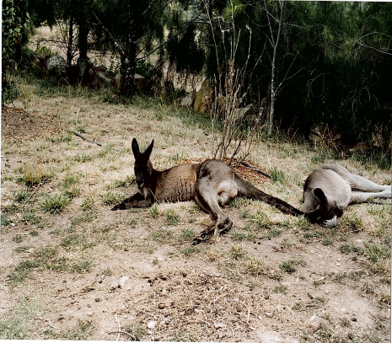
Ned & Billy

Slide 15
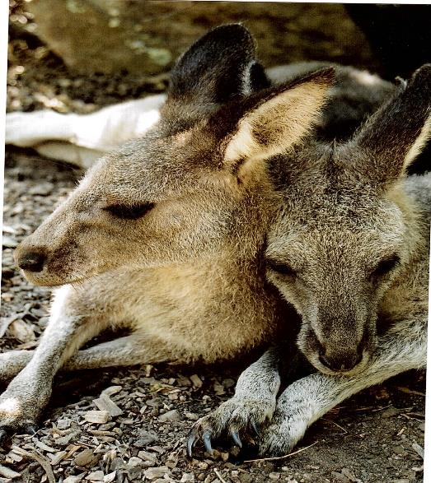
Flynn & Tulley

Slide 16
Babesia
Has been identified in kangaroos on the east coast of Australia
Babesia can cause renal failure
First case of Babesiosis in a human reported in 2012 in a patient from the south coast at The Canberra Hospital
Ticks are known vectors but are not common in Canberra/ Southern Tablelands area

Slide 17
Crystalluria
Macropod joeys need to be well hydrated otherwise they are at risk of developing crystals in the urine which can cause acute urine retention
A consequence can be acute renal failure and possible irreversible damage to the kidneys
Crystal nephropathy could cause chronic renal failure in kangaroos.

Slide 18
Exertional Rhabdomyolysis
An important and common problem in macropods and is often unrecognised initially
It is important if exertional rhabdomyolysis is suspected to give intensive fluid treatment. Any macropod subject to a stressful event should have a urine analysis done to check for myoglobin. The myoglobin causes a positive haemolysed red blood result on the dipstick

Slide 19
Summary
Important to recognise that acute renal failure can occur in certain situations such as severe dehydration and crystalluria so appropriate treatment can be given early
Consider renal failure in macropod joeys with failure to thrive and bag wetting and in larger macropod with lethargy, weight loss and increased water consumption
Any macropod with exertional rhabdomyolysis needs intensive fluid therapy to prevent the toxic effect of myoglobin on the kidneys and consequent chronic renal failure
Knowledge about renal failure in macropods is limited and mostly anecdotal.

