Slide 1
Renal Failure in Eastern Grey Kangaroos

Slide 2
Definition
Renal failure - when the kidneys cannot perform their normal functions, viz: excreting waste (eg urea and creatinine), balancing electrolyte levels (eg sodium and potassium), controlling body fluid, blood pressure, acid balance, and red blood cell production
Renal failure can be acute (often reversible) or chronic.

Slide 3
Causes of acute renal failure
Can include:
Dehydration
Hypovolemia
Rhabdomyolysis
Medication
Severe infection
Crystalluria.

Slide 4
Chronic renal failure
Cause often not obvious
Usually irreversible
May result from: Rhabdomyolysis, Crystal nephropathy, Babesia.

Slide 5
Symptoms
Acute renal failure – macropod passes little (highly concentrated) or no urine
Chronic renal failure – poor weight gain, lethargy, polydipsia, polyuria (often wet bags).

Slide 6
Consequences
Level of waste products increase in blood (urea, creatinine)
Anorexia
Lethargy
Hyperkalemia
Metabolic acidosis
Heart failure.

Slide 7
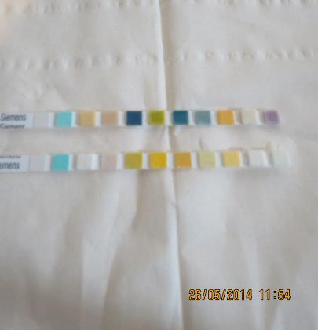
Diagnosis
Urine analysis
Low specific gravity (dilute urine)
Presence of protein and red blood cells
Confirm with blood test for
urea, creatinine and creatine
kinase (indicator of
myonecrosis).

Slide 8
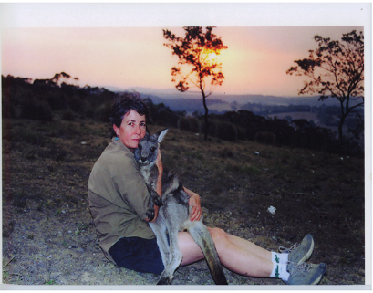
Rudi
Chased by dogs on hot day
Not treated aggressively for myopathy or to prevent renal failure
Very unwell for a number of weeks after incident most likely due to renal failure and was euthanased.

Slide 9
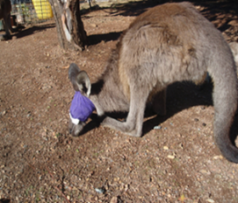
India
Parameter | Result | Std value*
Urea Creatinine Potassium CK | 164 1425 7.3 13399 | 8.6 mmol/L 133 umol/L 4.2 mmol/L 747 U/L
Eye injury in release enclosure
Treated with gentamicin for injury but not treated aggressively for myopathy
Developed renal failure. Note elevated urea, creatinine and potassium
Note elevated CK indicative of myonecrosis.

Slide 10
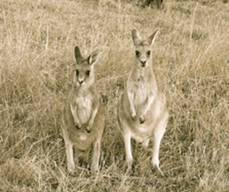
Pino
Came from another carer
Found after release unwell with fox attack injuries to the head
Consecutive blood test results indicated progression in her renal failure.
Parameter | Result 10/ 08/ 09 | Result 05/ 09/ 09 | Std Value*
Urea Creatinine Potassium CK Hb | 38 330 5.8 1223 99 | 56 520 4.9 8815 79 | 8.6 mmol/L 133 umol/L 4.2 mmol/L 747 U/L 154 g/L

Slide 11
Ned, Bob, Lenny, Tulley, Flynn
Fifteen years ago four released kangaroos died from what appeared to be renal failure
Ned was unwell for a long period. He lost weight, fur was unkempt and became very dark. He was euthanased
Bob had similar symptoms and had a cardiac arrest in the veterinary surgery
Lenny showed lethargy, weight loss, ‘aeroplane’ ears. VBA showed renal failure.

Slide 12
Ned, Bob, Lenny, Tulley, Flynn (Cont)
Tulley - weight loss, lethargy. Euthanased after having a seizure. Post-mortem histopathology indicated chronic kidney disease
Flynn – weight loss, lethargy. Treated with Imidocarb (recommended treatment for Babesia). Flynn made a full recovery.

Slide 13
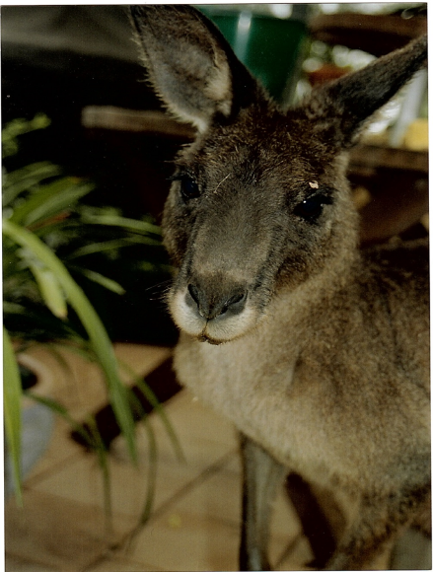
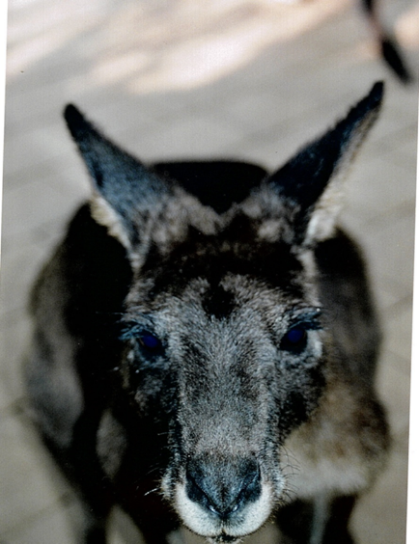
Ned

Slide 14
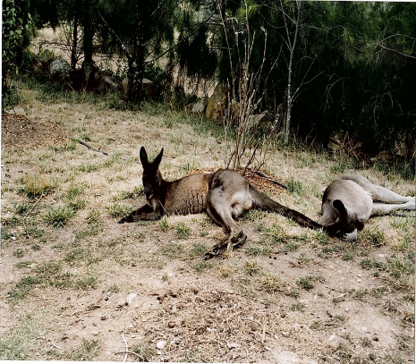
Ned & Billy

Slide 15
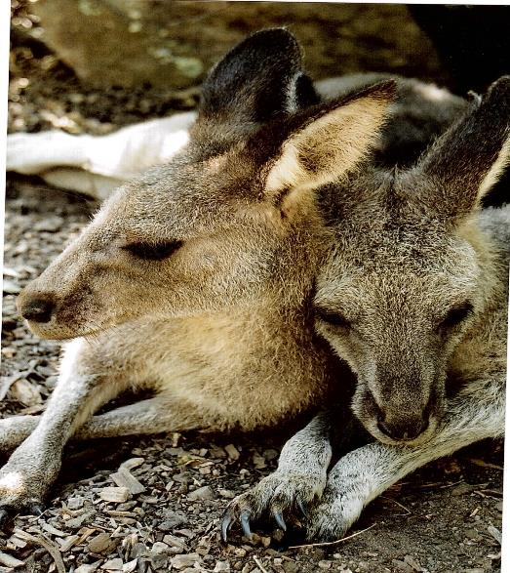
Flynn & Tulley

Slide 16
Babesia
Has been identified in EG kangaroos on east coast of Australia
Babesia can cause renal failure
First case of Babesiosis in a human reported in 2012 in a patient at The Canberra Hospital
Ticks are known vectors but are not common in Canberra/ Southern Tablelands area
The kangaroo flat fly is a possible vector.

Slide 17
Crystalluria
Macropod joeys need to be well hydrated otherwise they are at risk of developing crystals in the urine which can cause acute urine retention
A consequence can be acute renal failure and possible irreversible damage to the kidneys
Crystal nephropathy could cause chronic renal failure in EG.

Slide 18
Myopathy
An important and common problem in EG and is often unrecognised initially
Is important if myopathy is suspected to treat aggressively with fluids. Any macropod subject to a stressful event should have a urine analysis done.

Slide 19
Summary
Important to recognise that acute renal failure can occur in certain situations such as severe dehydration and crystalluria so appropriate treatment can be given early
Consider renal failure in EG joeys with failure to thrive and bag wetting and in larger EG with lethargy, weight loss and increased water consumption
Any EG with myopathy needs intensive fluid therapy to prevent the toxic effect of myoglobin on the kidneys and consequent renal failure
Knowledge about renal failure in EG is limited and mostly anecdotal.

